Slide 1


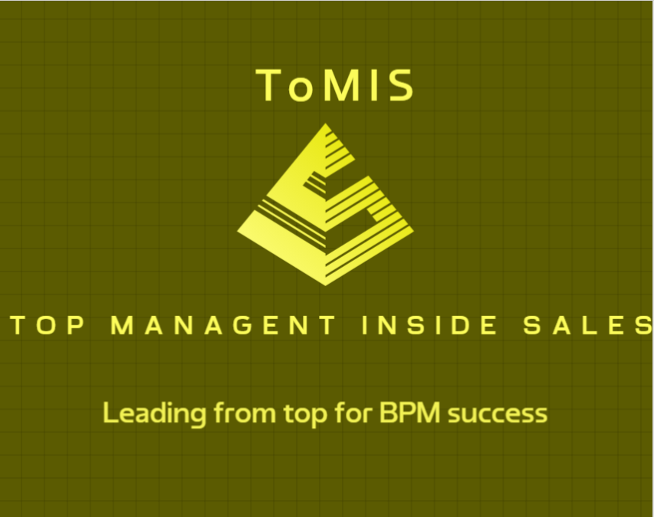


Juan Ramón Gutiérrez Villar
juraguvi@juraguvi.com
® All content, terms and definitions, including, logos, messages and expressions are legally protected and cannot be replicated without direct permission of D.X.O ® (Digital eXperience Operations ® ) Legal Owner. Contact juraguvi@juraguvi.com for authorization. Their reproduction, handling and/or plagiarism will be legally prosecuted.
® D.X.O® is legally registered under Intellectual property and should no be used without authorization from its brand owner. Visit https://juraguvi.com/d.x.o-r for more information.

Slide 2
Business Process Operational Transformation
BPOT collates the expertise from over 25 years of Consulting, 15 of which have been specifically focused on Business Process Management, implementation and automation systems, solutions design and implementation.
BPOT brings the most up-to-date trends in technology, tools and methods (Process Mining, Robotic Process Automation (RPA), AI and generative AI).
Business Process Architecture Definition (BPAD)
Continuous Process Optimization (PO)
Talent & Tools (T&T)
User experience (UX)
Continuous Process Optimization (CPO)
Business Process Architecture Definition (BPAD)
The definition of an adequate Business Process Architecture is the key to a successful Business Operational Transformation
Business processes are living elements that evolve in line with the company's improvement needs.
Talent & Tools (T&T)
User experience (UX)
Any transformation requires teams trained in the techniques and/or tools that respond to the operational needs of the business.
The sustainability of any Transformation program relies on the adoption of the results of the Transformation.

Slide 3
BPOT’s User experience
Business Process Architecture Definition
(BPAD)
Continuous Process Optimization
(PO)
DiMoDAR
Process Inventory
KPI – Def
BPD
TOM
LeanSixSigma
CBM
PIVAR
Benchmarking
RPA, DAP, ChatBots
Process Mining
Talent Coaching
AI, ML, LLM, Gen AI
IBM BWL
Change Management
Training
4 x I = C2
Talent & Tools
(T&T)
User experience (UX)

Slide 4

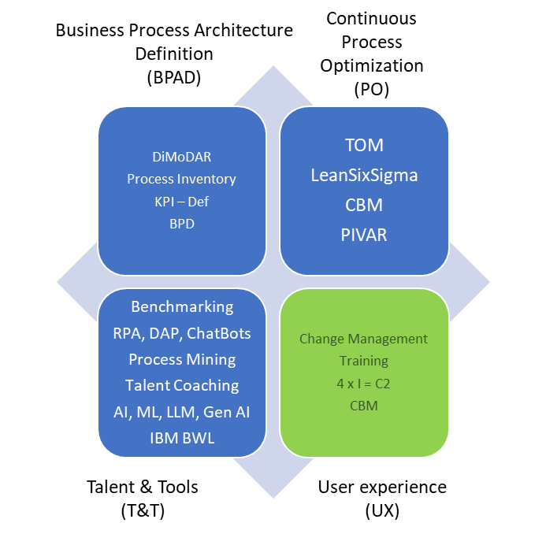



ToMIS: Top Management Inside Sales
BPOT’s User Experience
BPOT initiatives fail because Top Management Team is missing or not properly involved. This often occurs due to:
Business Misalignment: Transformation Plan is not in aligned with Strategic Objectives (OKRs)
Blurred message: Transformation message has not been clearly defined, agreed upon, or shared
Lack of Financial Feasibility/Confidence: ROI (Return of Investment) is unclear or simply does not exist
The Top Management Team does not get thrilled to LEAD AND SUPPORT BPOT initiatives.
BPOT “deal” NEEDS TO BE fully understood and “bought into” by Top Management Team to:
Warranty on-going alignment between company objectives (OKRs) and BPOT Plan
Maintain continuous, end-to-end, support to derived projects
Perceive and Acknowledge the value provided by BPOT Plan and project teams
Iteratively revalidate the investment
Let’s lead BPOT Initiatives “from the top” to succeed

Slide 5
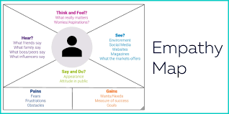
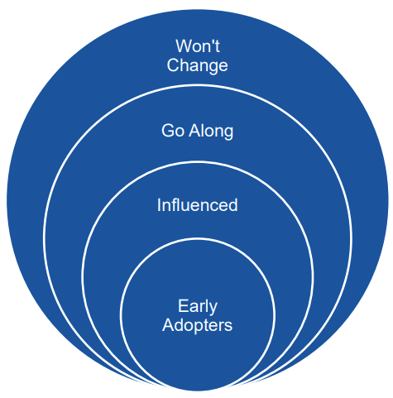
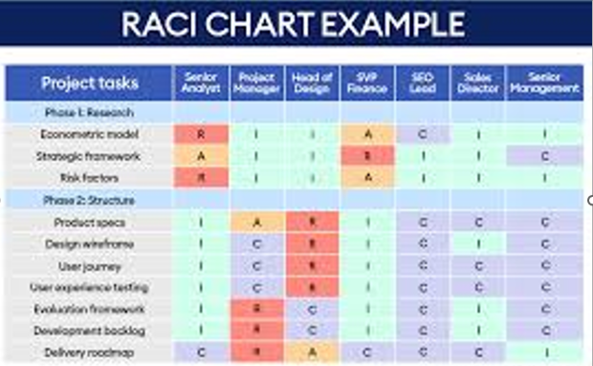
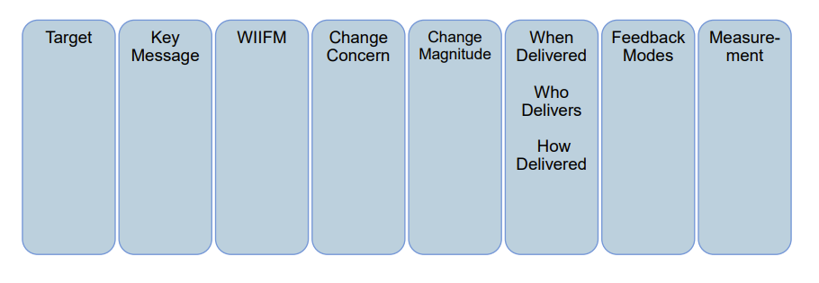
User Experience Framework
There are myriad methods, techniques, and tools for process optimization. The 'art' lies in how they are combined to pave the way to success.
4 X I = C²
IDETIFIED
INFORMED
INTERESTED
INVOILVED
COMMITTED
COLLABORATE
Empathy maps are a collaborative tool that teams can use to gain deeper insights into their target audience. Much like user personas, empathy maps can represent a group of users and provide a better understanding of their needs and potential adoption in transformation programs.
Venn-Audience diagrams help structure and focus change management efforts based on the expected reactions to the inevitable changes in any transformation project.
Adoption Dashboard:
Stakeholders’ Engagement Plan: is a proven technique based on the 4 X I = C2 rule to ensure drive stakeholder’s Commitment and Collaboration
RACI Matrix: is a classical method for the assignment and assumption of responsibilities across transformation programs.
Empathy maps help tailor and define an appropriate Communications Plan.

Slide 6
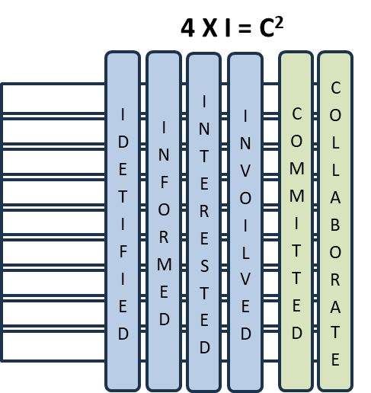
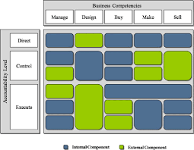
How does ToMIS work?
User Experience
Adoption of BPM Transformation Initiatives start at the top and should seamlessly flow across all the company.
ToMIS leverages User experience Framework to:
Use CBM Heatmaps
Build TOM and stakeholders’ Map
Explore BPM Empathy
Collect outcomes
Define TOM and Roadmap
Setup Focus on what matters
Collect Business Management needs and expectations
Create RACI matrix
360 º stakeholder’s perspective: hear, think, say, do
Use 4 X I = C2 technique
Elaborate Communication’s plan
Outline initial roadmap
Setup governance and tracking plan
Identify business’ areas requiring assistance
Measure sensible needs/metrics and threshold values
Share and agree Target Operating Model

Slide 7

Juan Ramón Gutiérrez Villar
juraguvi@juraguvi.com
http://www. juraguvi.com/services
® All content, terms and definitions, including, logos, messages and expressions are legally protected and cannot be replicated without direct permission of D.X.O ® (Digital eXperience Operations ® ) Legal Owner. Contact juraguvi@juraguvi.com for authorization. Their reproduction, handling and/or plagiarism will be legally prosecuted.
® D.X.O® is legally registered under Intellectual property and should no be used without authorization from its brand owner. Visit https://juraguvi.com/d.x.o-r for more information.

